Slide 1




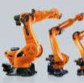


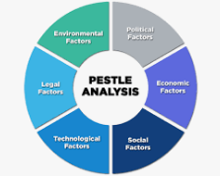

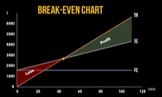
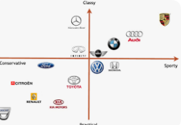

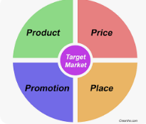



GCSE Business Learning Journey
Motivation
Different ways of working
Communication
Effective training and development
Effective recruitment
Ethics and Business
Business operations
Managing quality
Business and globalisation
Organisational structures
Environment and business
Technology, production, productivity
The sales process
Methods of growth
Introduction to the economy
Technology and business
Stakeholders
Changes in aims and objectives
YEAR
11
External influences on business
Legislation and business
Ownership & liability
Business location
Understanding business performance
Franchising
Business plans
Sources of finance for growth
Cash flow forecasts
Break even analysis
Revenue, costs and profit
Business calculations
Sources of finance for small businesses
Importance of cash
Market mapping
Marketing Mix
Price
Business aims & objectives
Place
Market research
Market segmentation
Competitive environment
Product
Promotion
Marketing mix decisions
Role of entrepreneurship
Role of enterprise
Why/How ideas come about
YEAR
YEAR
Customer needs
10
Adding value
Risk and Reward
Dynamic nature of business

