Slide 1




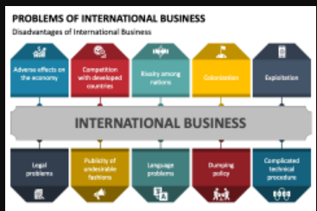
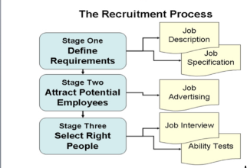


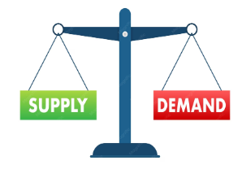


Change management and scenario planning
A Level Business Learning Journey
Human resources
Research task
Controlling MNCs
Ethics in global business
MNCs and their impacts
Cultural and social factors
In global marketing
Financial statements and ratio analysis
Shareholders vs Stakeholders
Corporate culture
Business ethics
Competitive environment
Business Growth
Reasons for staying small
Corporate Influences
External influences
Global marketing
And niche markets
Countries as production locations
Global mergers/joint ventures
Global competitiveness
Countries as markets
Protectionism and Trade Blocs
SWOT analysis
Prompts for global trade
Factors increasing globalisation
International trade and growth
Growing economies
Corporate objectives and Strategies
Quantitative sales forecasting
Decision Trees
Investment appraisal
Organisational design
Motivation theory and practice
Critical Path Analysis
Leadership
YEAR
Recruitment and selection
13
Stock control
Quality management
Economy, legislation and competition
Capacity utilisation
Production, productivity, efficiency
Business failure
Liquidity and liquidity ratios
Managing People
Marketing Strategy
Product life cycle and portfolio
Marketing mix
Price elasticity of demand
Income elasticity of demand
Introduction to marketing
Market positioning
Market research
Equilibrium
Sales forecasting
Sales, revenue, costs
Break even analysis
Budgets
Profit and profitability ratios
Demand and supply
Liability and finance
Planning and cash flow
Raising Finance
YEAR
YEAR
Business choices
12
Forms of Business
Business objectives
Entrepreneurs and Leaders

