Slide 1



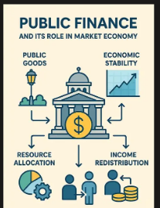
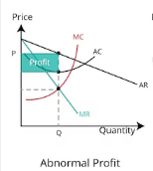
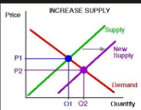
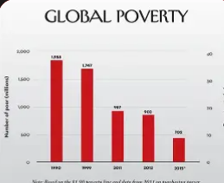
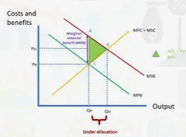
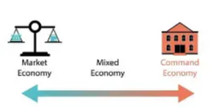

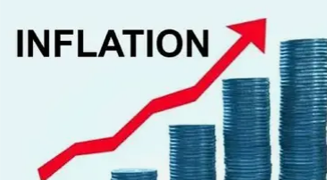

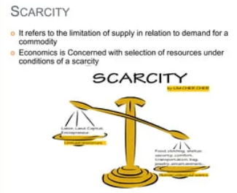
Learning Journey
Macroeconomics policies in a global context
Edexcel A level Economics A
Impacts of Govt. intervention
Govt. intervention
Wage determination
Supply of labour
Demand for labour
Public sector finances
Taxation
Public expenditure
Growth & Development influencers
Contestability
Int. competitiveness
Absolute & relative poverty
Inequality
Development measures
Exchange rates
Monopsony
Efficiency
Perfect Competition
Monopolistic competition
Monopoly
Balance of
payments
Profits and Losses
Oligopoly
Economies & Diseconomies of scale
Costs
Revenue
Business Objectives
Free trade restrictions
Demergers
Trading Blocs and WTO
Terms of Trade
Pattern of Trade
Specialisation & Trade
Information gaps
Globalisation
Business
Growth
Government intervention
Government failure
Theme 4
Public Goods
Year 13
Economic growth impacts
Demand-side policies
Objectives vs Policies
Theme 3
Sizes and types of firms
Externalities
Trade cycle
Macroeconomic objectives
Supply-side policies
Output gaps
Causes of growth
The multiplier
Equilibrium levels of real national output
Injections & withdrawals
Market failure
National Income
Consumer behaviour views
Indirect taxes and
subsidies
Price mechanism
Consumer and Producer surplus
long run AS
Consumer and Producer surplus
Rational decision making
Price determination
Demand
Elasticity of demand
Supply
Elasticity of supply
Free, Mixed and command economic structures
Consumption
Investment
Government expenditure
Net Trade
Aggregate Supply
Short run AS
Specialisation and division of labour
Aggregate Demand
Balance of payments
Employment & Unemployment
Inflation
Economic growth
Theme 2
Production possibility frontiers
YEAR
YEAR
12
The Economic problem
Positive and normative
statements
Economics as a
Social science
Theme 1

