Slide 1





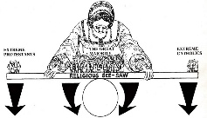
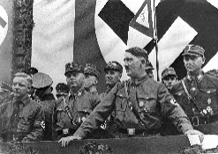
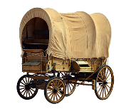
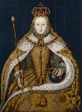

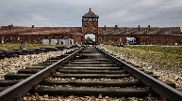

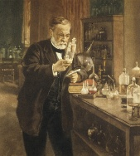
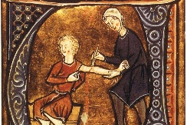
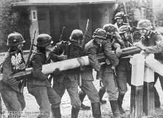
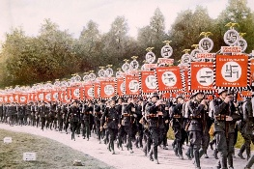
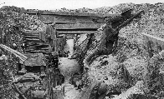
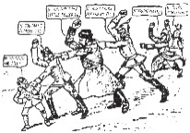


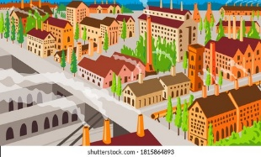



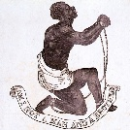
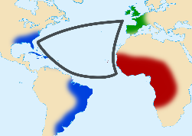




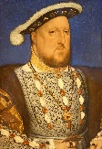


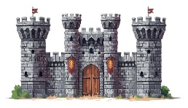

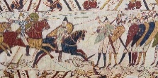
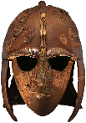
Revision Students will be following the exam timetable. Revision sessions will depend on the study leave timetable. Revision lessons will be arranged as appropriate in line with this timetable.
History Learning Journey
Nazi control and dictatorship, 1933–39
Life in Nazi Germany
Hitler’s Rise to Power 1919-1933
The Development of the Plains 1862–c1876
EDEXCEL Paper 2: option P3 The American West
Elizabethan Society and Culture
11
Queen, Government and Religion
The Weimar Republic
Later Developments in the West 1876–c1895
Early Settlement of the West 1835–c1862
Challenges to Britain at Home and abroad
EDEXCEL Paper 2: option B4 Early Elizabethan England, 1558–88
EDEXCEL Paper 3: Weimar and Nazi Germany, 1918–39
EDEXCEL Paper 1: The British sector of the Western Front, 1914–18: injuries,
treatment and the trenches
Why should we remember the Holocaust?
10
Medicine in Modern Britain
EDEXCEL Paper 1: Medicine in Britain, c1250–present
Medicine in Medieval Britain C1250-1500
1500-1700: Renaissance medicine
Medicine in 18th and 19th Century
How did World War 2 affect Civilians?
How has Migration changed the Face of London in the 20th Century
Was Hitler Responsible for World War 2?
How did Hitler gain control of Germany?
What was the experience of Trench Warfare?
What were the causes of World War 1
What was the impact of the British Empire on India?
9
Why were Industrial Towns so unhealthy?
How did the Average Person gain more power in the 19th and 20th Centuries
Why was the Slave Trade abolished in 1807
What was the impact of the Transatlantic Slave Trade on Africans?
Who is to blame for the execution of king Charles I?
What Made Mali one of richest Kingdom in History?
Why did people feel so strongly about the Crusades?
YEAR
8
What can Anne Herbert tell us about life during the Wars of the Roses
Why was the Tudor Period known as a religious rollercoaster?
Who was the greatest Mughal Emperor?
Did Rats and Rebels change people’s live completely?
How much did the Norman conquest change England?
YEAR
YEAR
7
Why did William win the Battle of Hastings?
What was Life like in Anglo Saxon England?
‘ We are not makers of history. We are made by history ’ Martin Luther King Jr

