Slide 1


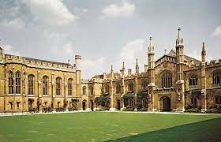
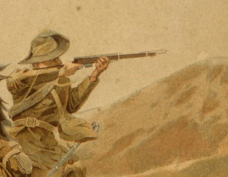
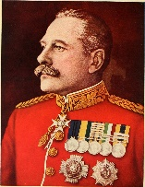
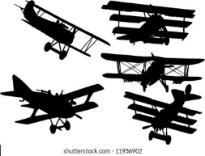


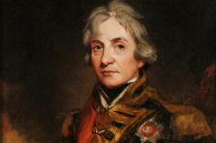
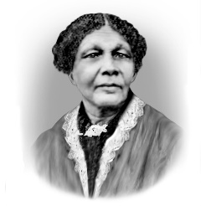


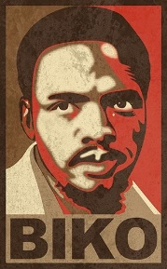
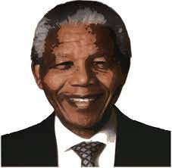


History 6th Form Learning Journey
School Logo Here
Careers, including:
Lawyer, Journalist teaching, data analysis, community worker,
University Options, including:
Teaching, Journalism and law
Apprenticeships in relevant industries
Full time work in social and community-based occupations
Theme 5- Britain and World War 1
The Western Front and attrition, effect of war reporting on government policy, evaluation of Haig and Battle of the Somme
Theme 6- the War in the Air 1914-1918
Effect of aerial recon, development of British and German air forces, impact of German bombing on public opinion
Theme 4- The Second Boer War
Responses to Guerrilla combat, development of railways, Black Week, effect of British commanders
Independent Coursework
Completion of coursework and development of exam technique
Independent Coursework
Production of an independent research essay based around critical discourse of the French Revolution
Coursework (Taught Element)- What was the French Revolution?
Declaration of Rights of Man, causes and events of the French Revolution, links to coursework
Theme 3- Crimea 1854-1856
Organisation of British Army, roles of Seacole and Nightingale, media coverage of Crimean War
Theme 2- The British and French Wars
The role of Wellington and Nelson, impact of French Wars
Theme 1- Aspects of the Changing Role of Government in Preparing the Nation at War
Army and naval reforms 1790-1918, impact of science and technology, role of civilians in warfare
Theme 3- Society and Culture 1917-1980
The changing role of women, consumerism, impacts of immigration in US, effect of popular culture (radio, cinema, TV)
Theme 4- The Changing Quality of life 1917-1980
Impacts of economic change, stagflation, War on Poverty, changes to American leisure
Theme 5- The impact of The Reagan Presidency
Impact of Reaganomics, deregulation of industry, effects on social groups, public political engagement
YEAR
13
Theme 3: Resistance and Challenges to National Party
Black consciousness, Steve Biko, external and internal pressures on apartheid, Bantustans
Theme 4: The End of Apartheid and the Creation of the “Rainbow Nation”
Township revolts, negotiations to end apartheid, De Klerk’s ‘new course’, freeing Mandela, extent of democracy
Theme 2 – Radicalisation and Resistance to Apartheid
Sharpesville Massacre, South Africa as a republic, radicalization of ANC and consolidation of apartheid
Theme 1: The Response to Apartheid: 1948-1959
Life in South Africa pre 1948, Afrikaner culture, introduction of apartheid and control, rise of ANC/PAC.
YEAR
YEAR
12
Theme 2-The Quest for Civil Rights 1917-1980
Jim Crow Laws, impact of New Deal, NAACP, rise of MLK, marginalized groups campaigns for equality
Theme 1- The Changing political Environment (1917-1980)
Aftermath of WW1, Great Depression/Boom, effect of war period on American presidency, interventionism
Successful GCSE’s
Level 4 or above in Humanities. English Language OR Literature + Maths

