Slide 1













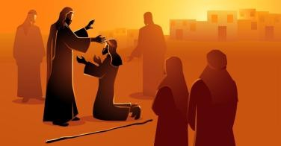


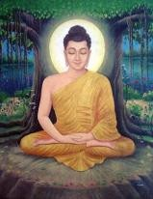
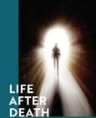
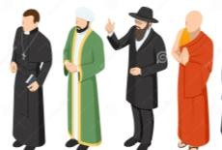


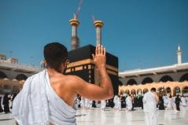
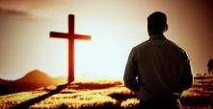
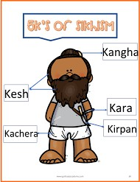
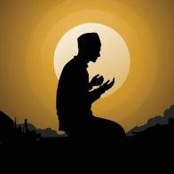




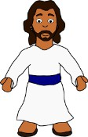
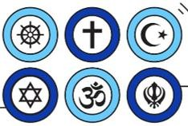



R.E Learning Journey
Revision Students will be following the exam timetable. Revision sessions will depend on the study leave timetable. Revision lessons will be arranged as appropriate in line with this timetable.
Analysing different beliefs on the use of the death penalty
Revision: Pupils to learn key revision
Exploring contrasting views on animal experimentation
Theme B: Religion and Life
techniques such as mind maps, exam technique and talk for writing strategies.
Analysing contemporary attitudes to homosexuality
Theme E: Crime and Punishment
Should countries be allowed to use weapons of mass destruction?
YEAR
11
Exploring contrasting beliefs on contraception
Theme A:
^{Theme D: Peace and} Explaining contrasting beliefs on
Religious views on sex before marriage
Relationships
^{Conflict – Explaining} abortion and euthanasia
contrasting beliefs
on violence
Pupils to explore different festivals within Islam
Analysing Christian views on Holy Communion
Identify the different types of punishment
Assessing if the death penalty is ever acceptable
Assessing different attitudes to the nature of God
Why are the five pillars important?
Christian Beliefs
Islam beliefs
Importance on the role of prophets
10
Is capital
Importance on life after death
punishment acceptable?
What is ethics?
Christian Practices: Analysing the different Christian Practices
How do we know what is right and wrong?
How might following Humanist beliefs affect a persons way of living ?
How might following the Buddha affect a person’s way of living?
Is there a God?
Exploring the life of Jesus
Comparing philosophical arguments on the existence of God
Why do humanists believe in just the one life?
Why are the parables of Jesus important?
What do Christians believe about Jesus?
Is there life after death?
How has religion influenced culture?
Exploring the importance of religious art
Exploring arguments for and against life after death
In depth study of how religion has influenced modern culture
9
How does worship impact the life of a Christian?
What influences a Christian way of living?
What are non-religious worldviews ?
Exploring principles within Atheism and Humanism
What influences a Muslims way of living?
Exploring how Christian beliefs impact behavior
In depth study of non-religious belief systems
Exploring how beliefs impact lifestyle
Exploring key Islamic beliefs
How did Islam become a global religion?
What do Sikhs believe?
Exploring the significance of the 5 K’s in Sikhism
Identifying key beliefs within Islam
What do Buddhists believe?
YEAR
8
An in depth study of Buddhism
Exploring the diversity within Islam
Assess the equality in Sikhism
What do Hindus
believe?
What do Jews believe about God?
In depth study of beliefs and practices in Hinduism
.
Assessing the impact of Jesus on Christianity
What is meant by religion and worldviews?.
Exploring key religious leaders in Judaism
YEAR
7
YEAR
How did Christianity become a global religion?
Developing Insights into different beliefs.
Understanding the nature of God
Exploring the impact of Christianity in the world.

