Slide 1

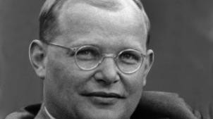
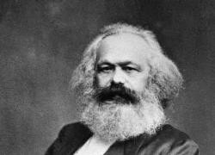
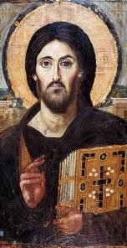



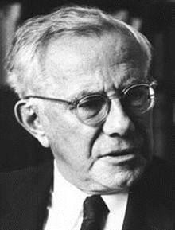
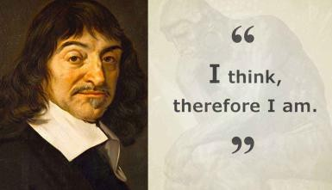

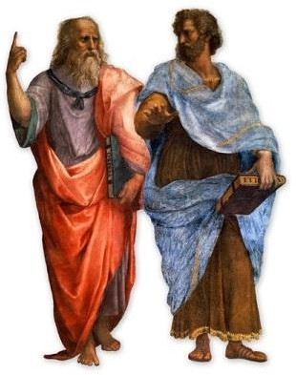



Religious Studies Learning Journey
School
Logo Here
Careers, including:
University Options, including:
Education
Community and social services
Law
Public Sector
Social Services
Ministry/Chaplaincy
Theology
Philosophy and ethics
Law
Social Sciences
Politics
International Relations
t
CHRISTIAN MORAL ACTION
RELIGIOUS PLURALISM
THE PERSON OF JESUS CHRIST
LIBERATION THEOLOGY & MARXISM
Post 18
BUSINESS ETHICS
ONTOLOGICAL ARGUMENT THE NATURE OF GOD
META ETHICAL THEORIES
SEXUAL ETHICS
RELIGIOUS LANGUAGE
DEATH AND THE AFTERLIFE
UTILITARIANISM
-
THE PROBLEM OF EVIL
CHRISTIAN BELIEFS AND TEACHINGS
ARGUMENTS BASED ON OBSERVATION
KANTIAN ETHICS
YEAR
13
Teleological argument
SOUL, MIND AND BODY
SITUATION ETHICS
Cosmological argument
YEAR
12
YEAR
RELIGIOUS EXPERIENCES
NORMATIVE ETHICAL THEORIES: RELIGIOUS APPROACHES
ANCIENT PHILOSOPHICAL INFLUENCES
Natural Law
Plato and Aristotle
Successful GCSE’s
Level 5 in English Language/Literature, History, Geography and/or Level 6 in RS

