Slide 1

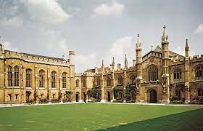

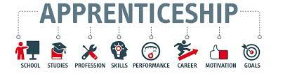



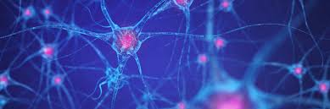

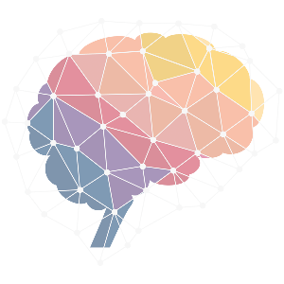

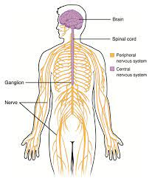




Psychology Learning Journey
School Logo Here
Go off to University
To study BSC In Psychology
Go on to specialise with a Masters
Clinical Psychology
Cognitive Neuroscience
Child development
Apprenticeships
Internships such as Business Psychology
Full time work
Schizophrenia
Issues and Debates
Free will vs Determinism
Nature vs Nurture
Social sensitivity in research
Aggression
MAOA Gene, SLT theory, Sexual Jealousy, Prisons
Paper Three Topics
Commence: Relationships topic including theories on formation, maintenance, Breakdown and Online dating
Biopsychology
Lateralisation, Types of Biological Rhythms, Brain Scan Techniques
Research Methods
Validity & Reliability
Statistical tests
Design an experiment
Approaches in Psychology
From learning theory to Psychodynamic
Psychopathology
Mental characteristics of ocd, phobias and depression alongside main theories and therapies for each of these
YEAR
13
Attachment
Learning and Bowlby's theory, Animal studies institutional care
Social influence conformity, obedience and social change
YEAR
Biopsychology
Fight or flight, types of neurons and the endocrine system
YEAR
12
Memory
Memory models, forgetting, eye witness testimony and cognitive interview
Research methods
Fundamentals of research design, sampling and types of experiments
Successful GCSE’s
Level 5 or above in English and Biology

