Slide 1













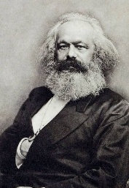
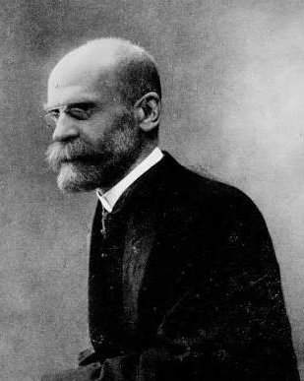







Sociology Learning Journey
School Logo Here
Careers, including:
Civil Service
Public Affairs
Journalism
Research and policy
Human resources
Marketing
Education
Social care
University Options, including:
Sociology
Criminology
International Relations
Law
Psychology
Education
Combined studies with another subject e.g. Economics, Marketing, History
Theories on crime and deviance
Labelling theories
Strain and subcultural theories
Functionalist
Interactionist
Realist
Marxist
Differences in crime and justice
Gender
Class
Ethnicity
Sociology theories
Sociology and Science, objectivity and values, action theories, social policy, globalisation and postmodernity
Post 18
Globalisation, green crime, human rights and state crime
Religion in the global context:
fundamentalist, globalisation
Changes and development in religion and beliefs
Secularisation, choice, ideology, organisations, movements, members
Crime and the media
Moral panic, folk devil
Crime control, punishment and victims
Family policies
Functionalist and New Right perspectives
Development over the years
Difference in educational achievement
Class, internal and external factors, gender, ethnicity
Applying research methods in the context of education
Theories and perspectives of religion
YEAR
13
Demographic changes
Births, deaths, divorce, marriage, migration
Education policy over the years and inequality
Couples
Domestic division of labour, equality, domestic violence
YEAR
YEAR
Sociology perspectives on the role of institutions in society
Families
Education
12
Childhood
Social construction of childhood, changes and developments over time
Research methods
Fundamentals of research design, sampling, practical, ethical and theoretical issues; Types of experiments, questionnaires, participant observations, interviews, secondary sources
Successful GCSE’s
Level 5 in English Language/Literature, History, Geography and/or Level 6 in RS

