Slide 1



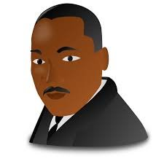


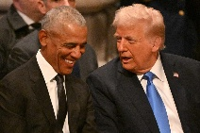




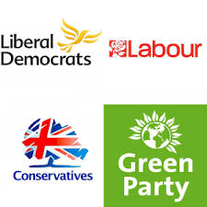

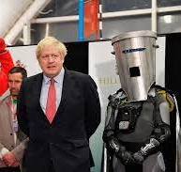
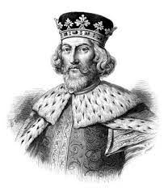

Politics
Learning Journey
School Logo Here
Careers, including:
Civil Service
Public Affairs
Journalism
Marketing
Accountancy
Human Resources
Detective
University Options, including:
Economics
History,
International Relations,
Politics,
Journalism,
Law,
International Relations
US Political Parties + Elections
US Pressure Groups + Civil Rights
US Judiciary
US Legislative
US President + Executive Office
US Constitution
Political Ideas: Socialism
Political Ideas: Conservatism
Political Ideas: Anarchism
Political Ideas: Liberalism
YEAR
13
UK Political Parties and Pressure Groups
UK Government: Prime Minister and Cabinet
YEAR
YEAR
12
UK Elections and Local Governments
UK Government: Judiciary Branch
Intro to Politics: History of Politics and Current Issues
Successful GCSE’s
Level 5 in History, Geography and/or Level 6 in RS

